Slide 1
Natural Language Programming with Python
Fall 2021

Slide 2
Housekeeping
In case of technical problems:
Something wrong on my end (e.g. power outage), I will send you an email.
Something wrong on your end, please send me a text message. 508-769-6446
jcodygroup@gmail.com
We have 4 hours for each session
I will try to give you an opportunity to stand and stretch every hour.
We will take at least one 15-minute break near the halfway point.

Slide 3
About me
Experience:
25+ years consulting and training experience
Extensive work with “big data” and analytics
15 years working with various data visualization tools
Education
Ed. M., Technology, Innovation & Education, Harvard University
PhD Candidate, Education Policy, University of Massachusetts, Amherst

Slide 4
NLP

Slide 5
What is Natural Language Processing (NLP)?
NLP is a broad field, encompassing a variety of tasks, including:
Part-of-speech tagging: identify if each word is a noun, verb, adjective, etc.)
Named entity recognition (NER): identify person names, organizations, locations, medical codes, etc
Question answering
Speech recognition
Text-to-speech and Speech-to-text
Topic modeling
Sentiment classification
Text Classification
Text Generation
Language modeling
Translation

Slide 6
I like to organize it this way…
What group does this text belong to?
What is in this text?
What can I say about this text?
Text classification
spam/not spam
finance/health/IT/etc.
semantic analysis
Named Entity Recognition
Topic Modeling
Text Summarization
Text Generation
Q & A
I have not included translation, speech-to-text, etc.

Slide 7
Our focus
NLP is a broad field, encompassing a variety of tasks, including:
Part-of-speech tagging: identify if each word is a noun, verb, adjective, etc.)
Named entity recognition (NER): identify person names, organizations, locations, medical codes, etc
Question answering
Speech recognition
Text-to-speech and Speech-to-text
Topic modeling
Sentiment classification
Text Classification
Text Generation
Language modeling
Translation

Slide 8
General Process Flow
Tokenization
Remove Contractions
Stop word removal
Spell Checking
Feature Engineering/ Dimensionality Reduction
Analysis/ Modeling
Stemming
Noise Removal
Documents of interest
Lemmatization
Specialized Cleaning
Sentiment Analysis
Text Summarization
Text Classification
Text Generation
Topic Modeling
Normalization
Cleaning
Pre-processing

Slide 9
Is NLP part of Machine Learning?
Yes.

Slide 10
Working in Google CoLab

Slide 11
Patient comments about prescribed medications
Our data set contains comments from patients about medications they have been taking.
Can we determine the sentiment (pos, neg, neutral) of new comments based on this data?

Slide 12
General Process Flow
Tokenization
Remove Contractions
Stop word removal
Spell Checking
Feature Engineering/ Dimensionality Reduction
Analysis/ Modeling
Stemming
Noise Removal
Documents of interest
Lemmatization
Specialized Cleaning
Sentiment Analysis
Text Summarization
Text Classification
Text Generation
Topic Modeling
Normalization
Cleaning
Pre-processing

Slide 13
Terminology
Algorithm: A set of rules/instructions/steps to follow in order to build a model.
Model: A mathematical equation that produces the desired output
NLP ‘Classifiers’ are algorithms
Naive Bayes Classifier
Linear Classifier
Support Vector Machine
Bagging Models
Boosting Models
Shallow Neural Networks
Deep Neural Networks
Convolutional Neural Network (CNN)
Long Short Term Modeler (LSTM)
Gated Recurrent Unit (GRU)
Bidirectional RNN
Recurrent Convolutional Neural Network (RCNN)
Other Variants of Deep Neural Networks

Slide 14
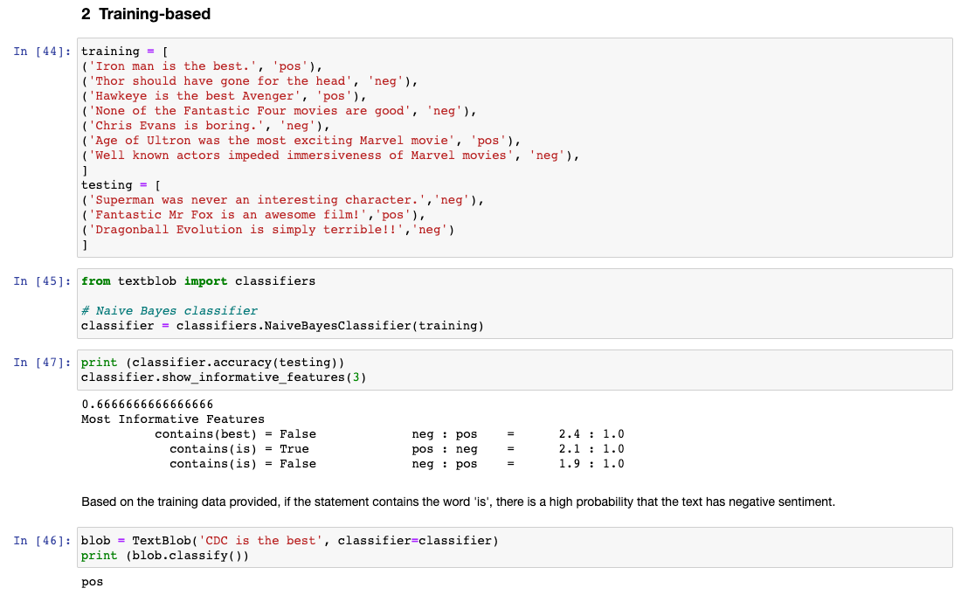
Machine Learning algorithms
Supervised
regression
Unsupervised
clustering

Slide 15
General Process Flow
Training dataset
Analysis/ Modeling
Test/Evaluate
Pre-process
Testing
dataset
Documents of interest

Slide 16
Where can we get data?

Slide 17
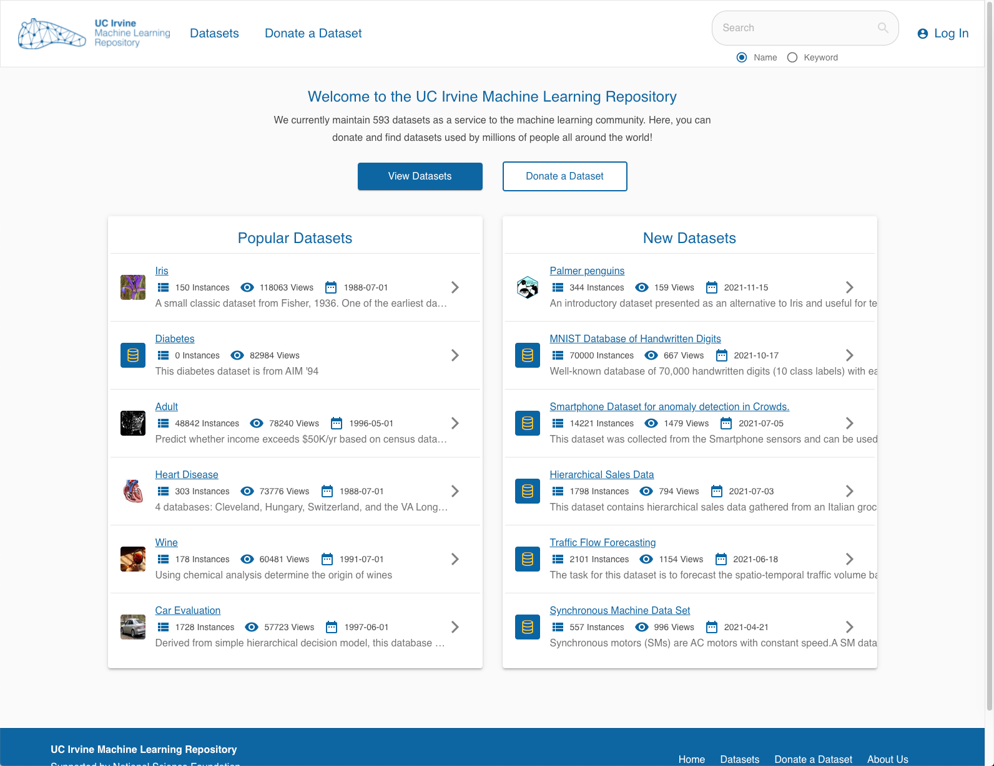
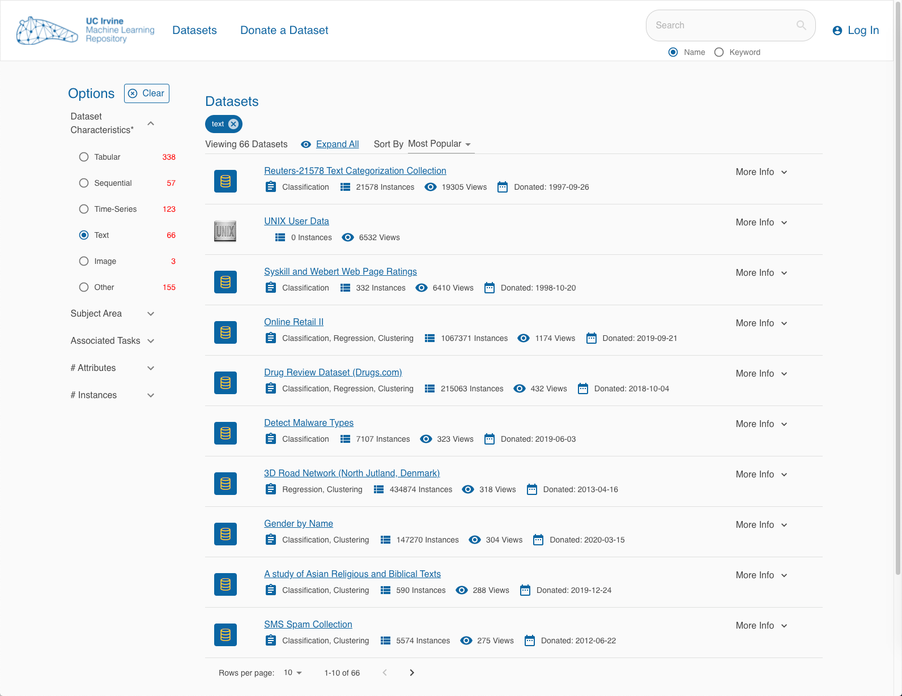
UCI data
UCI Machine Learning repository

Slide 18
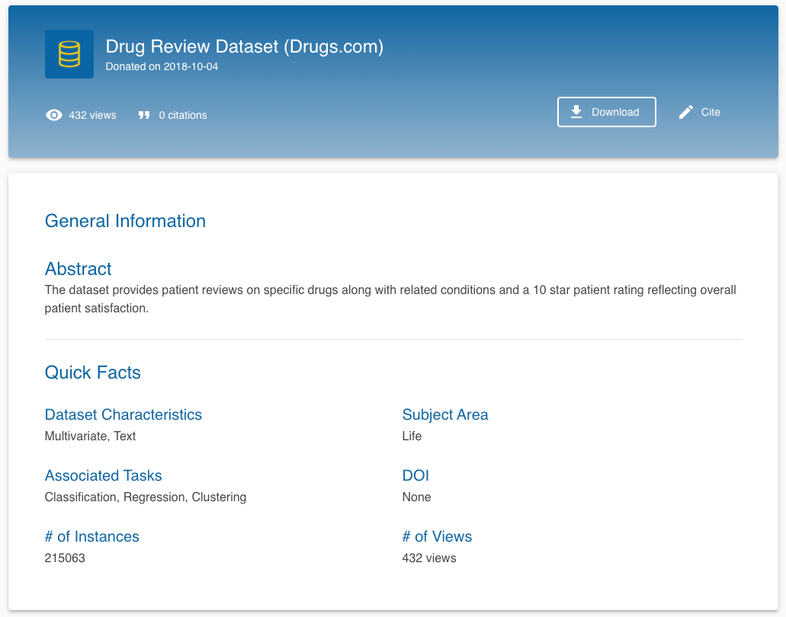
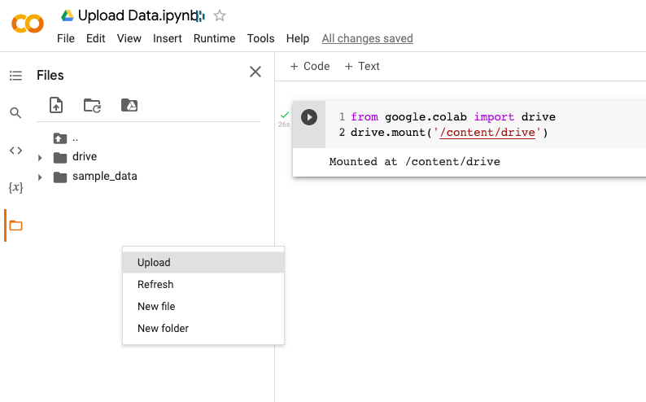
UCI data

Slide 19

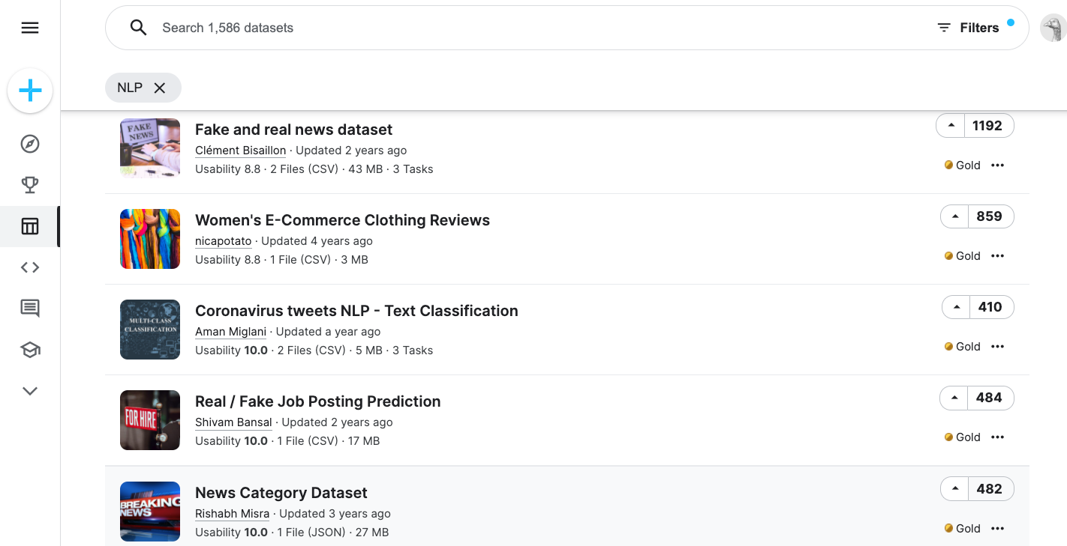
Sources of data
Kaggle

Slide 20
Pre-processing data
1 – Pre-processing

Slide 21
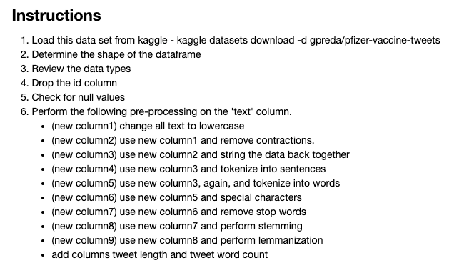
Exercise - Preprocessing
Use the Exercise – Preprocessing notebook as a starter

Slide 22
EDA with Text
2 – EDA with Text: Data with labels

Slide 23

We are moving slightly beyond EDA in this notebook
Feature engineering
Vectorization
Corpus
Document Matrix

Slide 24
Feature Engineering
Raw text data will be transformed into feature vectors and new features will be created using the existing dataset.
Bag of Words: all the words in the corpus without reference to what came before or after
N-grams (beyond unigrams): sets of words can provide more context about the relationship between words.
CDC has a lot of scientist > ‘CDC has’, ‘has a’, ‘a lot’, ‘lot of’, ‘of scientist’
Count vectors: matrix notation of the dataset in which every row represents a document from the corpus, every column represents a term from the corpus, and every cell represents the frequency count of a particular term in a particular document.
TF-IDF vectors: represents the relative importance of a term in the document and the entire corpus.
TF-IDF score is composed by two terms: the first computes the normalized Term Frequency (TF), the second term is the Inverse Document Frequency (IDF), computed as the logarithm of the number of the documents in the corpus divided by the number of documents where the specific term appears.
Word embedding - A word embedding is a form of representing words and documents using a dense vector representation. The position of a word within the vector space is learned from text and is based on the words that surround the word when it is used. Word embeddings can be trained using the input corpus itself or can be generated using pre-trained word embeddings such as Glove, FastText, and Word2Vec. Any one of them can be downloaded and used as transfer learning.
Text/NLP features – counts of nouns, verbs, words, characters

Slide 25
Exercise – EDA with text
Use your Exercise – Preprocessing notebook
Add columns for polarity and subjectivity.
Create charts to show distributions of :
polarity
retweets
user followers
user friends
favorites
review length
word count
polarity by location
retweets by location
After stop words have been removed, what are the top 10:
unigrams
bigrams
Add two other charts or tables you think might be interesting to see.

